Slide 1
NFA to DFA
Notes:
Cpt S 317: Spring 2009
School of EECS, WSU

Slide 2
Conversion from NFA to DFA
Let, M = (Q, ∑, δ, q0, F) is an NFA which accepts the language L(M). There should be equivalent DFA denoted by M' = (Q', ∑', q0', δ', F') such that L(M) = L(M').

Slide 3
Conversion from NFA to DFA (cont’d...)
Step 1: Initially Q' = ϕ
Step 2: Add q0 of NFA to Q'. Then find the transitions from this start state.
Step 3: In Q', find the possible set of states for each input symbol. If this set of states is not in Q', then add it to Q'.
Step 4: In DFA, the final state will be all the states which contain F(final states of NFA)

Slide 4
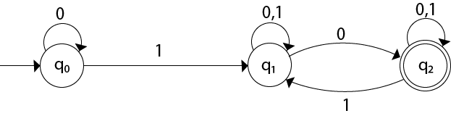
Conversion from NFA to DFA (cont’d...)
Example 1:
Convert the given NFA to DFA.

Slide 5
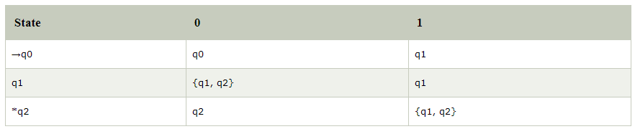
Conversion from NFA to DFA (cont’d...)
Solution: For the given transition diagram we will first construct the transition table.

Slide 6
Conversion from NFA to DFA (cont’d...)
Now we will obtain δ' transition for state q0.
δ'([q0], 0) = [q0]
δ'([q0], 1) = [q1]
The δ' transition for state q1 is obtained as:
δ'([q1], 0) = [q1, q2] (new state generated)
δ'([q1], 1) = [q1]
The δ' transition for state q2 is obtained as:
δ'([q2], 0) = [q2]
δ'([q2], 1) = [q1, q2]
Now we will obtain δ' transition on [q1, q2].
δ'([q1, q2], 0) = δ(q1, 0) ∪ δ(q2, 0)
= {q1, q2} ∪ {q2}
= [q1, q2]
δ'([q1, q2], 1) = δ(q1, 1) ∪ δ(q2, 1)
= {q1} ∪ {q1, q2}
= {q1, q2}
= [q1, q2]

Slide 7
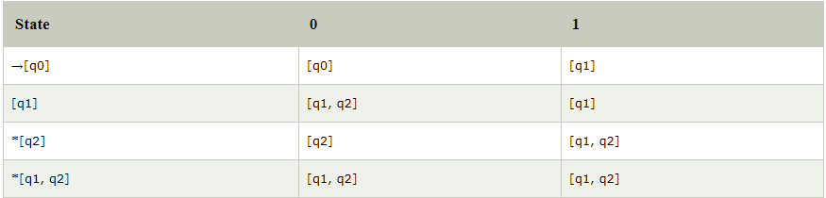
Conversion from NFA to DFA (cont’d...)
The state [q1, q2] is the final state as well because it contains a final state q2. The transition table for the constructed DFA will be:

Slide 8
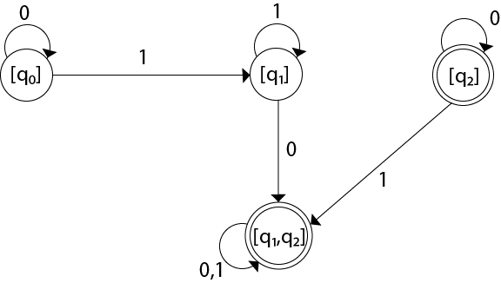
Conversion from NFA to DFA (cont’d...)
The Transition diagram will be:
The state q2 can be eliminated because q2 is an unreachable state.

Slide 9
NFA to DFA construction: Example
L = {w | w ends in 01}
1
0
NFA:
DFA:
[q₀]
0
[q₀,q₁]
1
[q₀,q₂]
0,1
0
0
1
1
q₀
q₁
q₂
δ_{N} | 0 | 1
q₀ | {q₀,q₁} | {q₀}
q₁ | Ø | {q₂}
*q₂ | Ø | Ø
Notes:
Cpt S 317: Spring 2009
School of EECS, WSU

Slide 10
A bad case where #states(DFA)>>#states(NFA)
L = {w | w is a binary string s.t., the k^{th} symbol from its end is a 1}
  NFA has k+1 states
  But an equivalent DFA needs to have at least 2^{k} states
(Pigeon hole principle)
  m holes and >m pigeons
    => at least one hole has to contain two or more pigeons
Notes:
Cpt S 317: Spring 2009
School of EECS, WSU

Slide 11
Discussion Questions
Please refer
TB_A2_NFA to DFA_Q.doc
TB_A2_NFA to DFA_Ans.doc

